Slide 1
TL3 Testing Presentation
Presented by: Zach, Leo, Kade, & Brandon

Slide 2
What makes a good Test Plan?
Presenter: Kade McRae

Slide 3
Clarity of Scope
Presenter: Kade McRae
Define everything you are/are not testing
What features are being tested?
What is being explicitly tested and why?

Slide 4
Clear Pass/Fail Conditions
Presenter: Kade McRae
How do I know a test passed?
Clear messages
Specific number conditions

Slide 5
Levels of Testing
Presenter: Kade McRae

Slide 6
Unit Testing
Presenter: Kade McRae
Module of component tested in isolation

Slide 7
Integration Testing
Presenter: Kade McRae
Where we test a group of modules
Four Types of Integration Testing:
Big Bang Integration
All modules required to be completed and integrated
Top Down Integration
Testing flow starts from top level modules in hierarchy
Bottom Up Integration
Start from lower level then move up
Hybrid Integration
Combo of top down and bottom up starting at mid layer

Slide 8
System Testing
Presenter: Kade McRae
Complete integrated application tested as a whole

Slide 9
Acceptance Testing
Presenter: Kade McRae
Ensures product meets specified business requirements
Alpha and beta testing

Slide 10
Course Requirements
Presenter: Kade McRae

Slide 11
Requirements
Presenter: Kade McRae
Initial test plan due before TL3 weekly status update
30 test cases MUST be done by oral exam
Justify that one test case saved time during debugging

Slide 12
Boundary Tests
Presenter: Zach Current

Slide 13
What is a boundary test?
Presenter: Zach Current
A boundary test checks behavior right at the edge of allowed input. Examples include minimum health, maximum inventory size, score limits, or values just below and just above a threshold.
• Good boundary values usually include: the minimum valid value, the maximum valid value, one value just below the valid range, and one value just above it.
• For simple parameterized unit tests in Unity, NUnit’s [TestCase] attribute is a clean way to supply multiple inputs to one test method.
Important: Unity’s documentation notes that [TestCase] works with normal unit tests, while [UnityTest] should generally use [ValueSource] instead of [TestCase].

Slide 14
Example
Presenter: Zach Current
For function:
public static int ClampScore(int score)
{
return Mathf.Clamp(score, 0, 100);
}

Slide 15
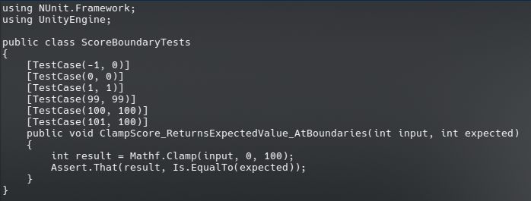
Example (cont)
Presenter: Zach Current

Slide 16
Things to Note
Presenter: Zach Current
Each [TestCase] line becomes a separate test run with its own input values.
If one input fails, the others can still pass, which makes it easier to see exactly which boundary broke.
Name tests around behavior, not implementation details. A good test name tells your classmates what should happen.

Slide 17
Stress Tests
Presenter: Leo Nelson

Slide 18
What is a stress test?
Presenter: Leo Nelson
A stress test evaluates how a system behaves when under heavy load (or stress!)
The test starts with normal working conditions and gradually increases the load until the system either completely fails or begins to show performance issues.
The point where a system fails is referred to as the break point.

Slide 19
Example: Login System Stress Test
Presenter: Leo Nelson
A stress test can be used to find how many users can log in at the same time before system slowdown or failure.
Test Process:
Start with 10 users logged in
Increase to 100
Increase to 500
Increase to 1000
Monitor system performance and errors
The first point where the system becomes unstable is the break point.

Slide 20
Things to Note
Presenter: Leo Nelson
Stress tests should start with a passing condition.
Gradual increase amount should be adjusted depending on your project. For some projects, a 100 increase is a lot, while for others it is negligible.
Stress tests are used to identify limits before real users encounter them.

Slide 21
Initial Test Plans
Presenter: Brandon Lunney

Slide 22
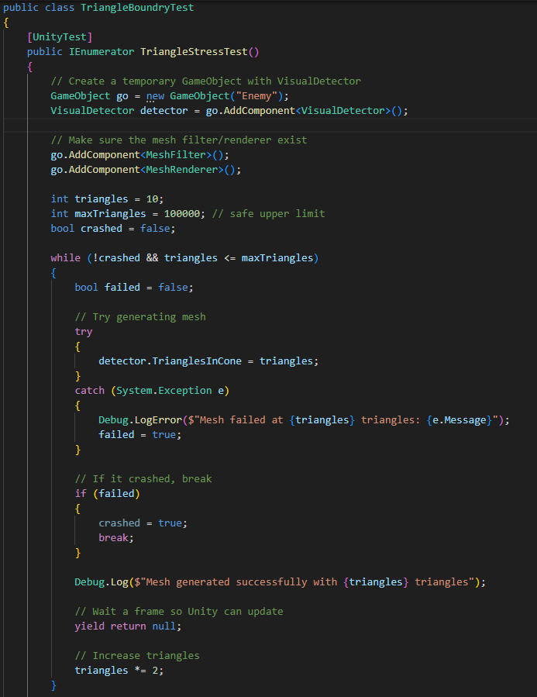
Initial Test Plan for Fruit of the Witch
Presenter: Brandon Lunney
Boundary Test
Testing the boundary of how many triangles can be in the detection cone.
Testing where the amount of triangles are too much.
It continuously doubles the amount of triangles until it breaks pr hits 100000
Safe up to 100000

Slide 23
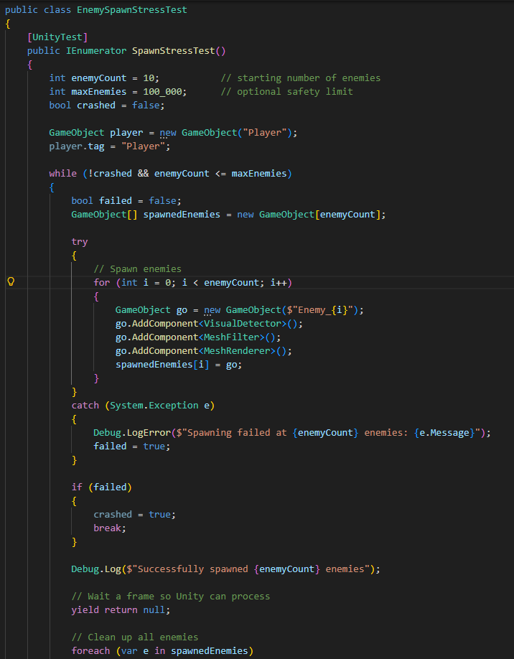
Initial Test Plan for Fruit of the Witch
Presenter: Brandon Lunney
Stress Test
Testing the stress by spawning in a ton of enemies.
Testing where the amount of enemies are too much.
It continuously doubles the amount of enemies until it breaks or hits 100000
Safe up to 100000 enemies with detection cones at once.

Slide 24
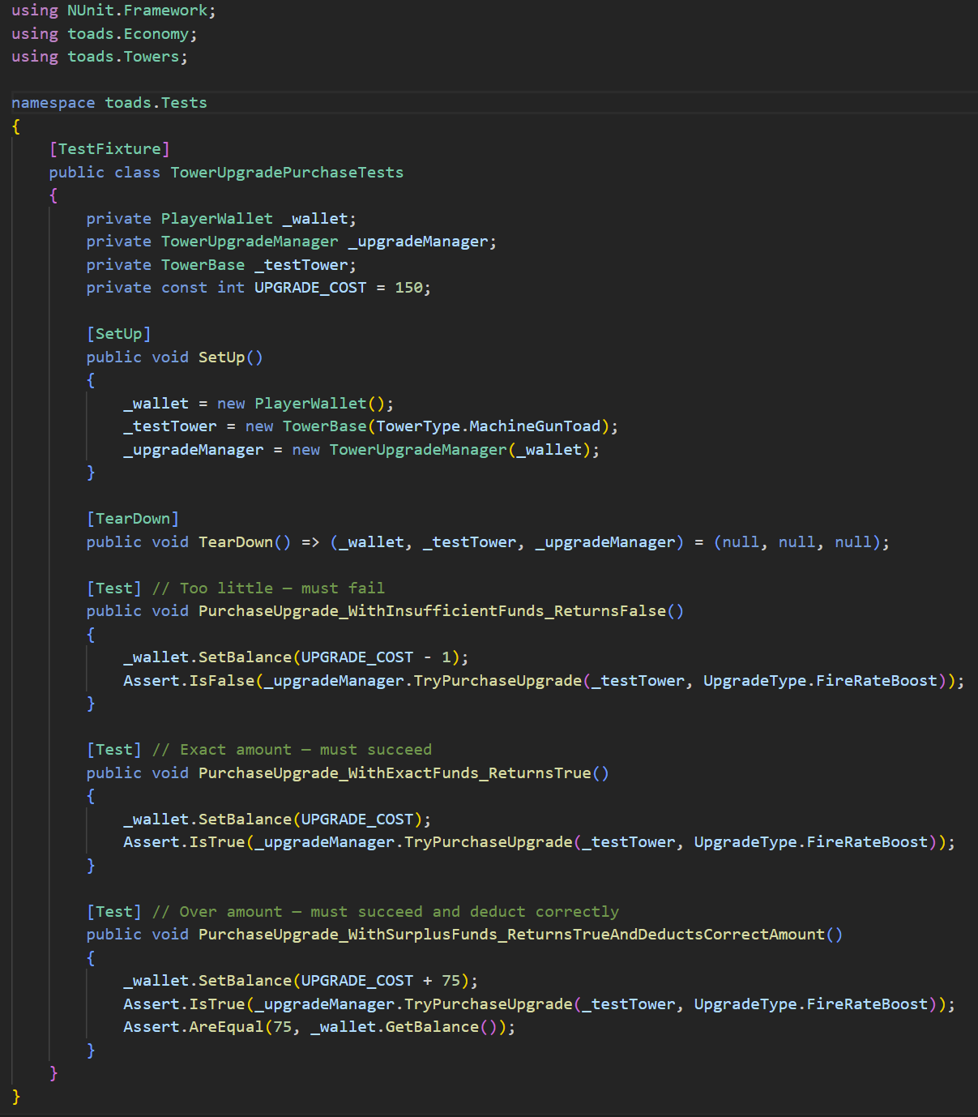
Initial Test Plan for Toads With Guns
Presenter: Zach Current
Boundary Test:
Tests whether or not the game lets you buy tower upgrades
Too little money: can’t buy it
Exact amount of money: can buy it
Over the amount of money: can buy it
Pass/fail: The fail condition is if you can buy it with too little money, or can’t buy it with enough or over the requisite amount.

Slide 25
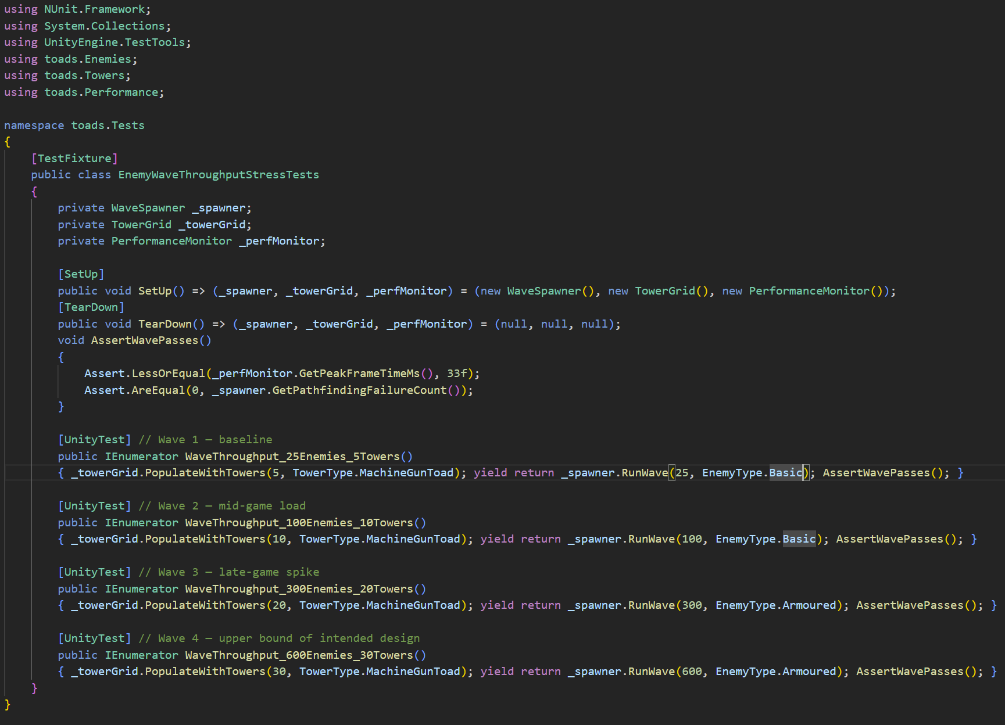
Initial Test Plan for Toads With Guns
Presenter: Zach Current
Stress Test:
What it tests: Simultaneous enemy and tower load without simulation breakdown.
Passing condition: Frame time <=33ms and zero pathfinding failures at every wave size.
Ramping up: 25 -> 100 -> 300 -> 600 enemies, towers scale alongside each wave. After 600 enemies keep doubling until something breaks.
Breaking point: First wave where frame time exceeds 33ms or pathfinding failures exceed 0.

Slide 26
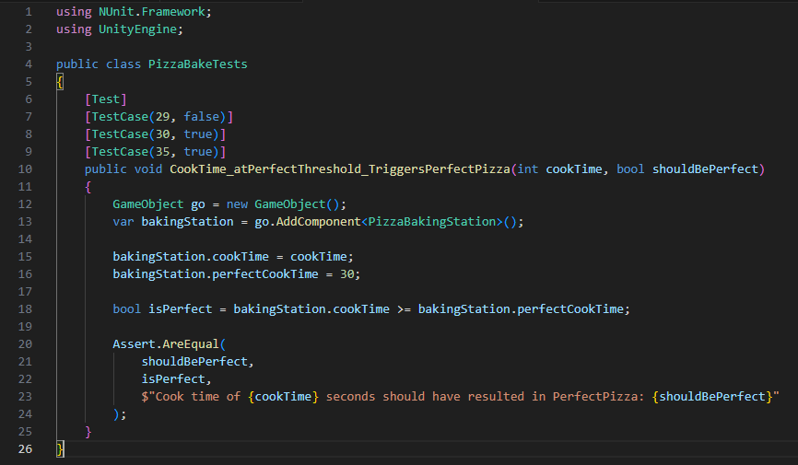
Initial Test Plan for ET’s Pizzeria
Presenter: Leo Nelson
Boundary Test:
Tests cookTime >= perfectCookTime threshold in PizzaBakingStation
29 seconds will NOT trigger PerfectPizza
30 seconds SHOULD trigger PerfectPizza
35 seconds SHOULD trigger PerfectPizza
Pass/Fail: Each test case runs the assertion which gives clearly labeled pass/fail message:
“Cook time of X seconds should have resulted in PerfectPizza: T/F”

Slide 27
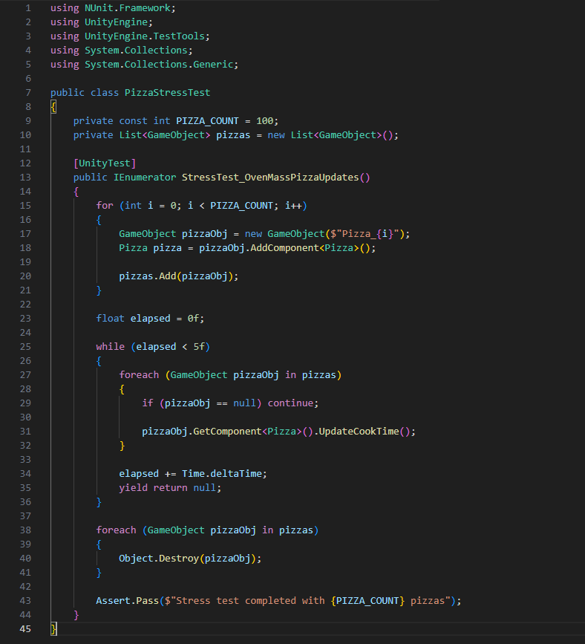
Initial Test Plan for ET’s Pizzeria
Presenter: Leo Nelson
Stress Test:
PIZZA_COUNT represents the number of pizzas that is being processed in the oven. The test will increase the number of pizzas in the oven to determine how many pizzas the game can handle before performance unity gives up.
Start at 10 - 100 - 500
System starts performance issues at 500 pizzas so that is the stress break point.

Slide 28
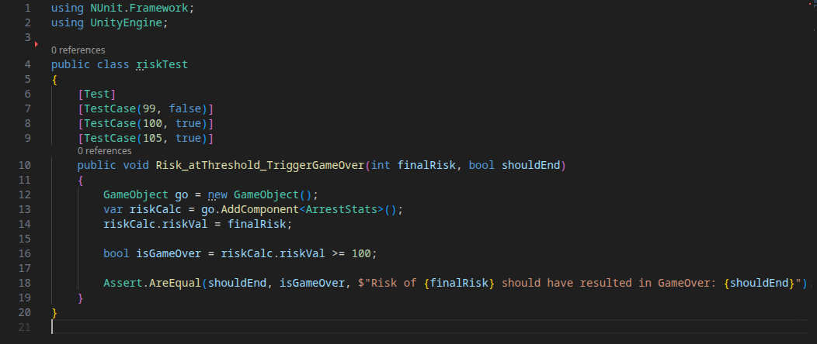
Initial Test Plan for Starfish Studios
Presenter: Kade McRae
Boundary Test:
Tests riskVal>=100 game over threshold in ArrestStats
99 should not trigger gameOver
100 should trigger gameOver
105 should trigger gameOver
Pass/fail: Each test case runs the assertion giving a clear labeled pass or fail message “Risk of X should have resulted in gameOver: true/false”

Slide 29
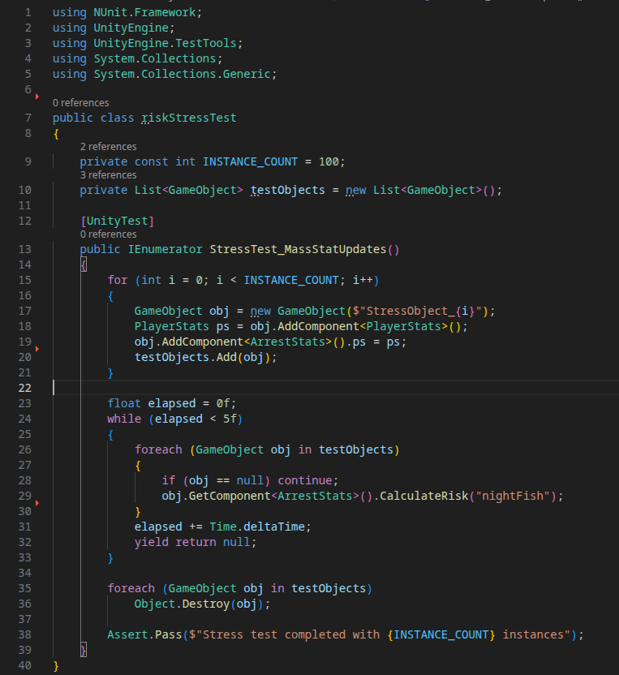
Initial Test Plan for Starfish Studios
Presenter: Kade McRae
Stress Test:
INSTANCE_COUNT are the amount of iterations the code runs, we want to see how many of these before the game BREAKS
Started at 10 -> 100 -> 1000
Out of memory errors occurred at 1000

Slide 30
Design Patterns & The Gang of Four
Presenter: Brandon Lunney

Slide 31
What are Design Patterns?
Presenter: Brandon Lunney
Reusable solutions to common problems in software design.
They are like a blueprint that helps you structure your code.
Benefits when used correctly:
Improved Code Organization
Easier to Maintain Code
Builds Proven & Reusable Solutions
Creates a Shared Vocabulary Among Developers

Slide 32
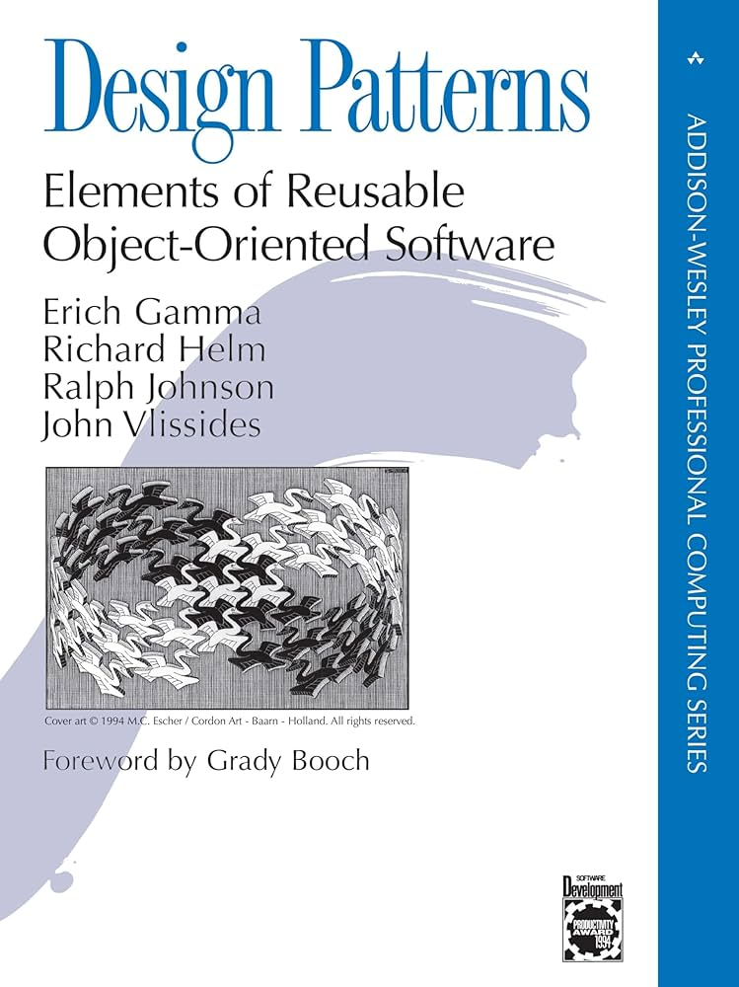
Who Are the Gang of Four (GoF)?
Presenter: Brandon Lunney
Formalized 23 Classic Design Patterns in their Book “Design Patterns”.
They observed & documented recurring solutions that experienced developers were already using.

Slide 33
The Three Categories of GoF Patterns
Presenter: Brandon Lunney
Creational: Deals with how Objects are Created
EX. Singleton, Builder, +3 Others…
Structural: Deals with How Classes & Objects are Combined
EX. Facade, Decorator, +5 Others…
Behavioral: Deals with How Objects Communicate
EX. Strategy, Command, +9 Others…

Slide 34
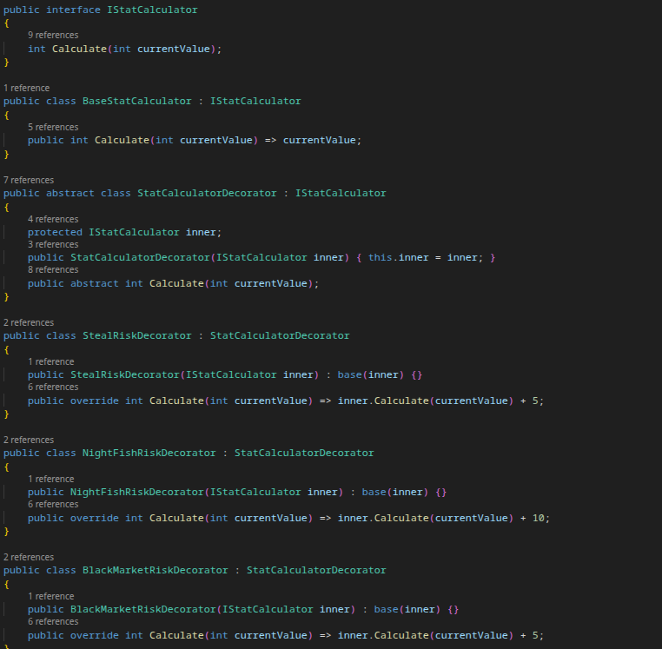
The Decorator Pattern in Just Fishing
Presenter: Kade McRae
Wraps an object to add behavior dynamically without changing the original class
Stacks behaviors by wrapping calculators inside each other
Invoked by
IStatCalculator calculator = new BaseStatCalculator();
//wraps based on action string
riskVal=calculator.Calculate(riskVal);
Without decorator, it would be a giant switch statement that grows with every action

Slide 35
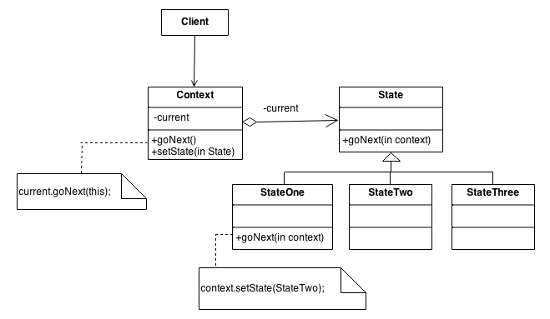
The State Pattern in Fruit of the Witch
Presenter: Brandon Lunney
This pattern fits nicely with my Detection State Machine.
A Detection Agent sends information to the Detection State Machine
DSM updates the status of all Enemies
What it Enables:
I will be able to add new Detection States that manipulate Enemies stats in isolation

Slide 36
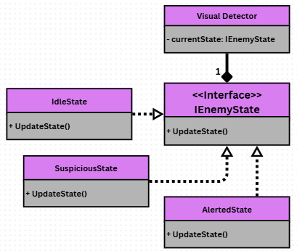
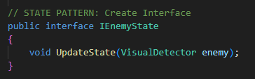
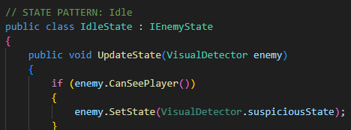
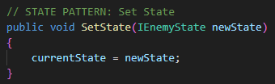
Implementation in Fruit of the Witch
Presenter: Brandon Lunney
Interface:
States Implementing Interface:
Transition Method:

Slide 37
Other Patterns in the Fruit of the Witch
Presenter: Brandon Lunney
Sound Engine: Singleton
We only ever want one sound engine in the game.
UI Manager: Facade
Allows for each system to only have to interact like UIManager.ShowPauseMenu();
Player Controller: State
Allows for easily changing between different movements.
Level Manager: Factory
Allows for “Spawn Points” that can call EnemyFactory.Create(“BCinator”)
Enemy AI: Strategy
Allows for the detection methods for different enemies to take different forms (Termal vs. Standard Vision )
Boss Fight: Command
Allows for the abstraction of attacks so we can add and modify new ones easily.

Slide 38
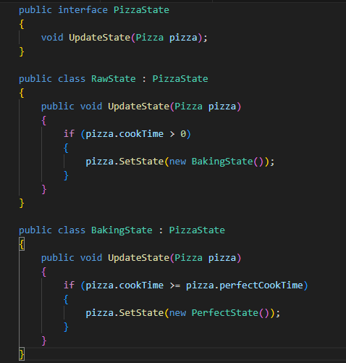
The State Pattern in ET’s Pizzeria
Presenter: Leo Nelson
Changes object behavior based on its current state without modifying anything within the main class.
Separates baking logic into different pizza states instead of a large conditional statement
States include:
Raw
Baking
Perfect
Burnt
This is invoked by PizzaState state = new RawState();
state.UpdateState(pizza);
Without the state pattern the baking logic would become an extremely large chain of if/else
statements that check cook time and pizza condition.

Slide 39
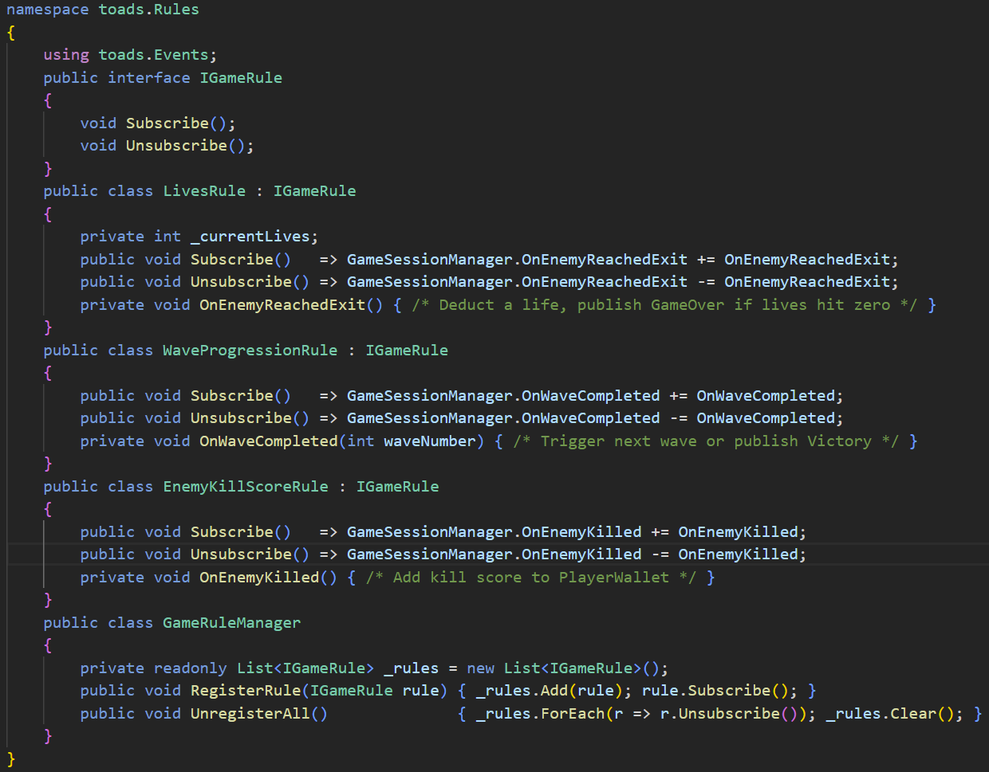
The Observer Pattern in Toads With Guns
Presenter: Zach Current
Pattern: Observer
Rules are decoupled listeners; nothing in the codebase needs to directly call a rule, it simply reacts to events broadcast by the GameSessionManager.
Why it fits
Tower defense games have many independent systems (lives, scoring, wave progression) that all respond to the same game events
Adding or removing a rule requires zero changes to existing code
Rules can be toggled at runtime without structural changes
What we needed to implement it
A static GameSessionManager that publishes all game events
An IGameRule interface enforcing Subscribe / Unsubscribe on every rule
A GameRuleManager to register rules and manage their lifecycle
Each rule subscribes only to the events it cares about and handles them in isolation

Slide 40
How to Get in Touch
Presenter: Kade McRae
If you are confused and need any help throughout the break, please make sure to send us a Discord message and we would be happy to help out!

